Slide 1
Infobasic
Notes:
© 2006 Capgemini - All rights reserved
0

Slide 2
Objective
At the end of this session, participants will
Appreciate features of Built-in Functions

Slide 3
What is Built-in Function?
Functions developed in the Core, for use in programming

Slide 4
Why Built-in Functions?
When programming includes long codes
Confusion is created
Programming is not clear

Slide 5
Various commands
INPUT
DISPLAY
PRINT

Slide 6
Various Built-in Functions
LEN
INDEX
COUNT
DCOUNT
UPPERCASE
DOWNCASE
CHANGE
ICONV
OCONV
PROMPT

Slide 7
Various Built-in Functions
TRIMF
TRIMB
TRIM
FIELD
LOCATE
FIND
FINDSTR

Slide 8
INPUT
Accepts a value for a variable from user
Syntax:
INPUT VARIABLE
INPUT VARIABLE,LENGTH
Notes:
Value entered is stored in variable ‘VARIABLE’
Value of length ‘LENGTH’ is stored in variable ‘VARIABLE’

Slide 9
DISPLAY
CRT – Places text and data on terminal
Syntax:
CRT @(Column,Row):TEXT/VARIABLE
Notes:
Text/data placed in column,row position

Slide 10
PRINT
Prints the value of variable or text
Used in conjunction with INPUT statement that prompts user input
Syntax:
PRINT @(COLUMN,ROW): TEXT/VARIABLE

Slide 11
Difference
PRINT | CRT
Used in both database and jShell prompt | Used in jShell prompt

Slide 12
Example
Write a program
To receive an input of Customers no. and age
To print the input Customer no. and age

Slide 13
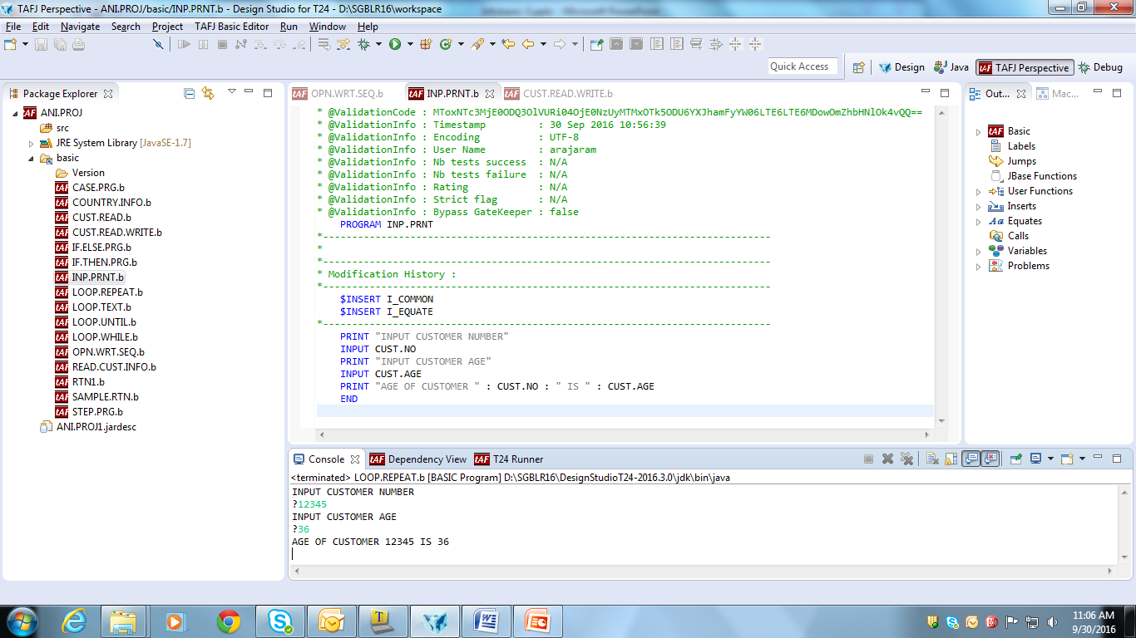
Solution
Write a program to receive input and to print data, using INPUT and PRINT functions

Slide 14
DATA
Accepts data if the response to INPUT statement is to be given without entering input
Syntax:
DATA expr1,expr2
Where,
expr1 & expr2 may evaluate to any data type
Each comma separated expression will be viewed as one line of terminal input i.e. expr1 & expr2 can contain expressions within itself (,expression …)

Slide 15
DATA
Example
Input:
DATA "Y", "N", "CONTINUE" ;* stack input for prog
EXECUTE "PROGRAM1" ;* execute the program
Output:
PROGRAM1 is executed & its output is displayed

Slide 16
Example
Write a program
To initialize variable
To assign it to variable available in INPUT statement
To print the data using variables of INPUT statement

Slide 17
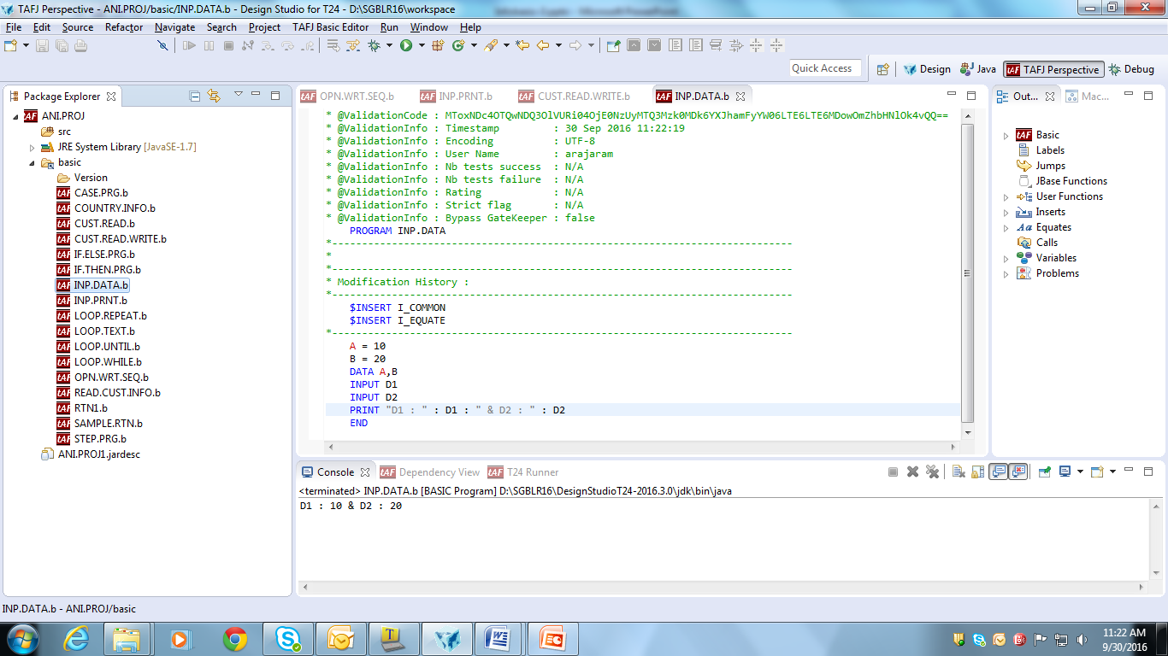
Solution

Slide 18
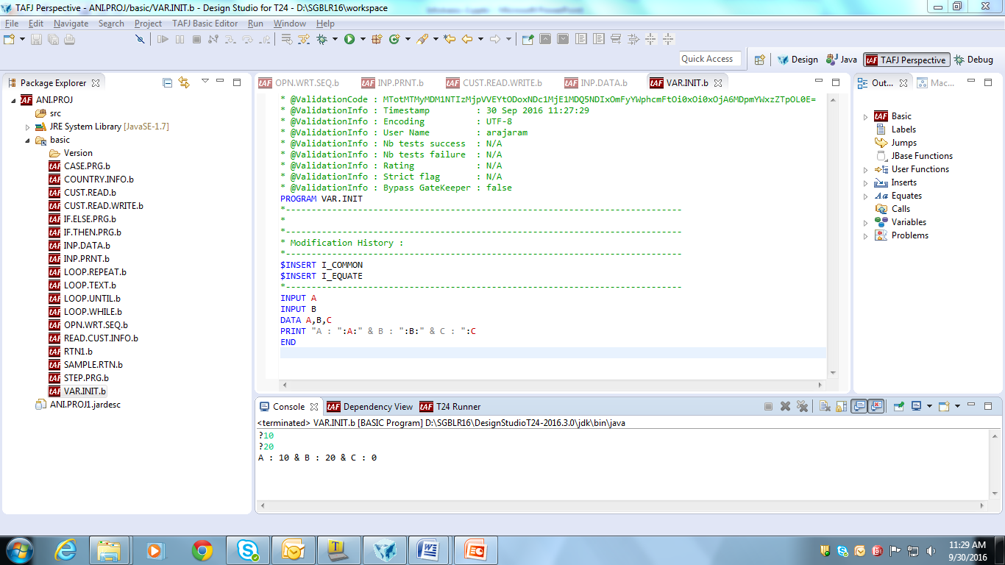
Uninitialized Variable
If a variable is not assigned with value, it takes a default value as zero.

Slide 19
LEN
Calculates the length of the supplied expression
Syntax:
LEN(expression)
Where,
expression can evaluate to any type and the function will convert it to a string automatically

Slide 20
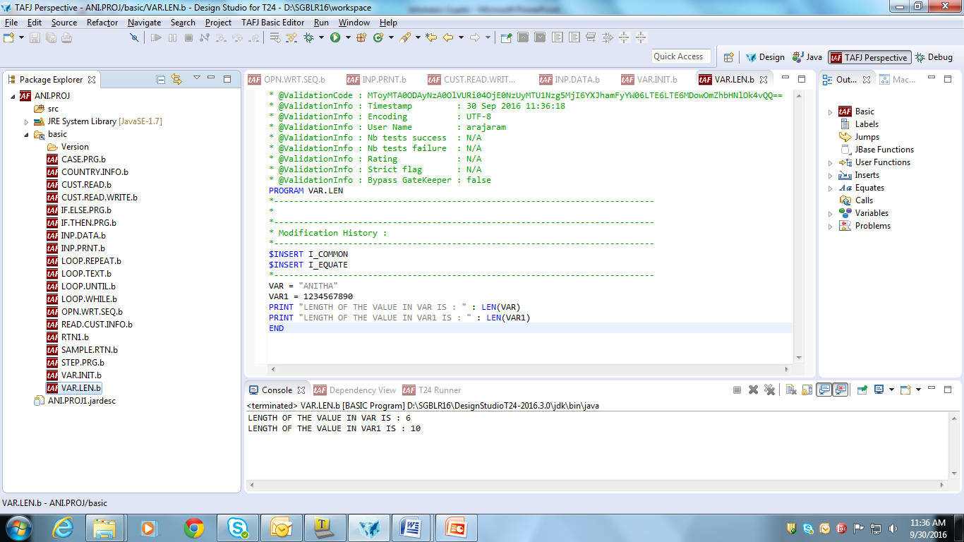
LEN
EXAMPLES
Input:
Lengths = LEN(Values)
PRINT Lengths
Output:
6

Slide 21
INDEX
Returns the starting position of specific occurrence of a substring within a string
Syntax:
INDEX(string,substring,occurrence)
Example
Input:
ABet = "abcdefghijklmnopqrstuvwxyzabc"
PRINT INDEX(ABet, "a", 1)
PRINT INDEX(ABet, "a", 2)
PRINT INDEX(ABet, "jkl", 1)
Output:
1
27
10
Notes:
NOTES
If the specified occurrence of substring cannot be found in string then 0 is returned.

Slide 22
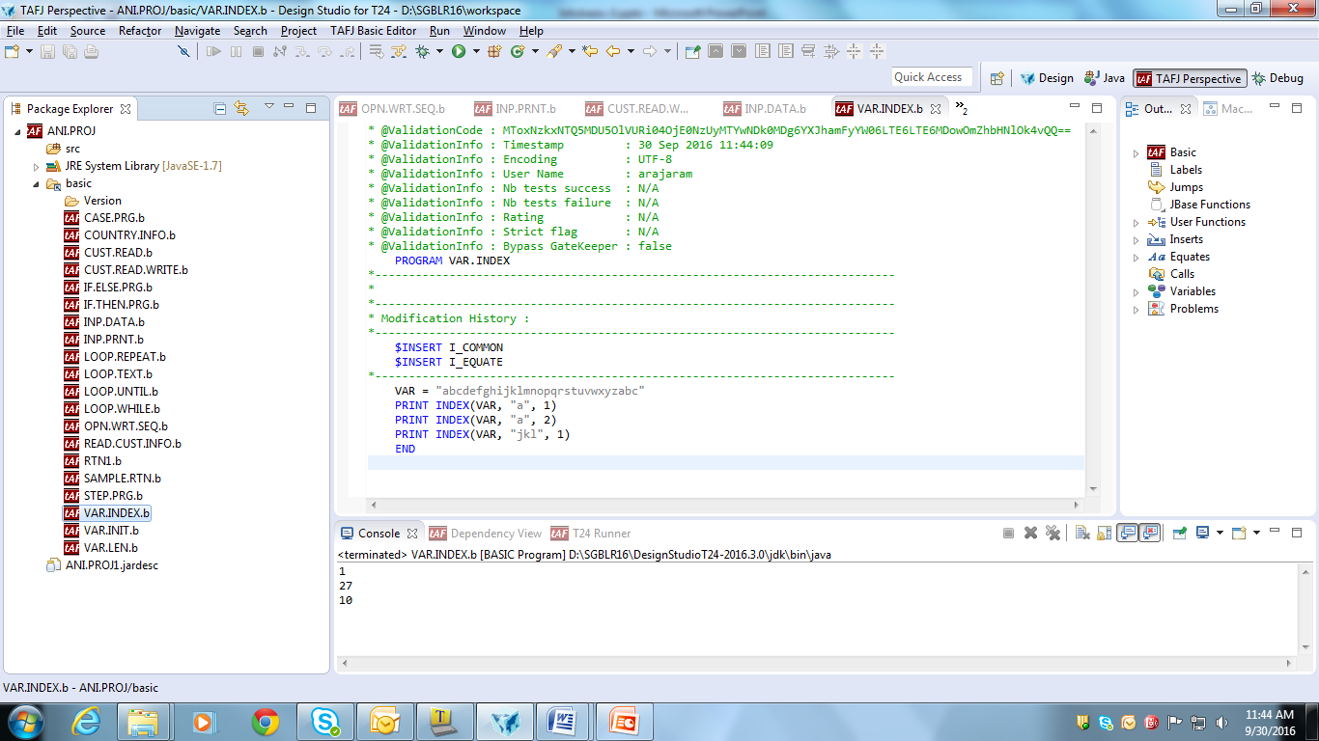
INDEX

Slide 23
COUNT
Counts the occurrence of a character in a string/variable/record
Syntax:
COUNT(expression1, expression2)
Where,
Both expression1 and expression2 may evaluate to any data type but logically they will evaluate to character strings
Example:
Input:
Calc = "56 * 23 / 45 * 12"
PRINT "There are ":COUNT(Calc, "*"):" multiplications“
Output:
There are 2 multiplications
Notes:
NOTES
The count is made on overlapping occurrences as a pattern match from each character in expression1
This means that the string jjj occurs 3 times in the string jjjjj

Slide 24
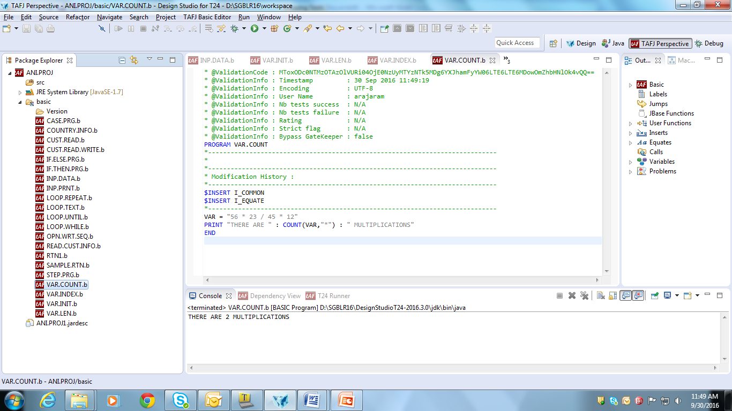
COUNT

Slide 25
Workshop
Write a program
To count the occurrence of character ‘I’ in the word ‘CAPGEMINI’
To find the length of the word ‘CAPGEMINI’
To find the 2nd occurrence of ‘I’ in the word ‘CAPGEMINI’

Slide 26
DCOUNT
Counts the occurrence of delimiters in a string/variable/record
Syntax:
DCOUNT(expression1, expression2)
Where,
expression1 evaluates to a string in which fields are to be counted
expression2 evaluates to the delimiter string that will be used to count the fields
Example:
Input:
A = "A:B:C:D"
PRINT DCOUNT(A, ":")
Output:
4
Notes:
NOTES
The delimiter string may consist of more than 1 character
If expression1 is a NULL string, then the function will return a value of 0
The delimiter string may consist of any character, including system delimiters such as field marks or value marks

Slide 27
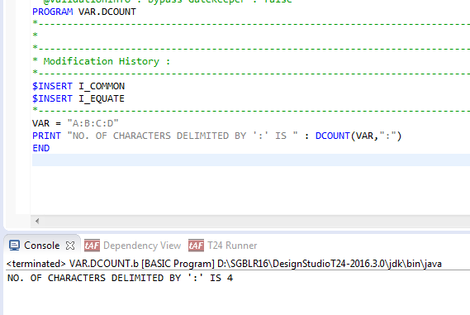
DCOUNT

Slide 28
Example
Write a program
To count the occurrence of value markers in a record
To count the number of occurrence of delimiting of record using value marker
Solution:
Initialize data containing value markers to a variable/record
Use COUNT and DCOUNT functions, to count occurrence of value marker and delimiting of record

Slide 29
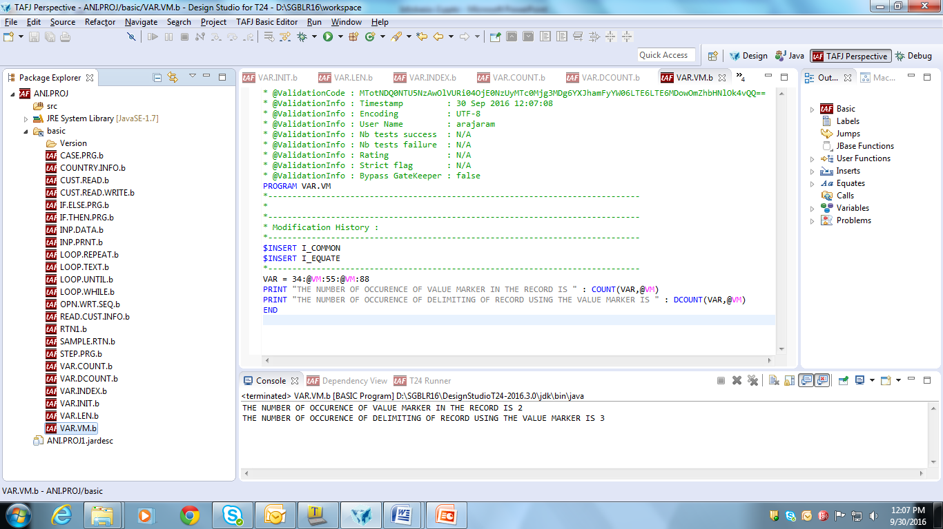
Solution

Slide 30
UPPERCASE
Converts case of character from lower to upper case
Syntax:
UPCASE(expression)
Where,
expression in a string containing some alphabetic characters
Notes:
NOTES
Non-alphabetic characters are ignored
The function LOWCASE is synonymous with DOWNCASE

Slide 31
DOWNCASE
Converts case of character from upper to lower case
Syntax:
DOWNCASE(expression)
Where,
expression in a string containing some alphabetic characters

Slide 32
Example
Write a program to convert the string:
‘CAP’ to lower case
‘gemini’ to upper case

Slide 33
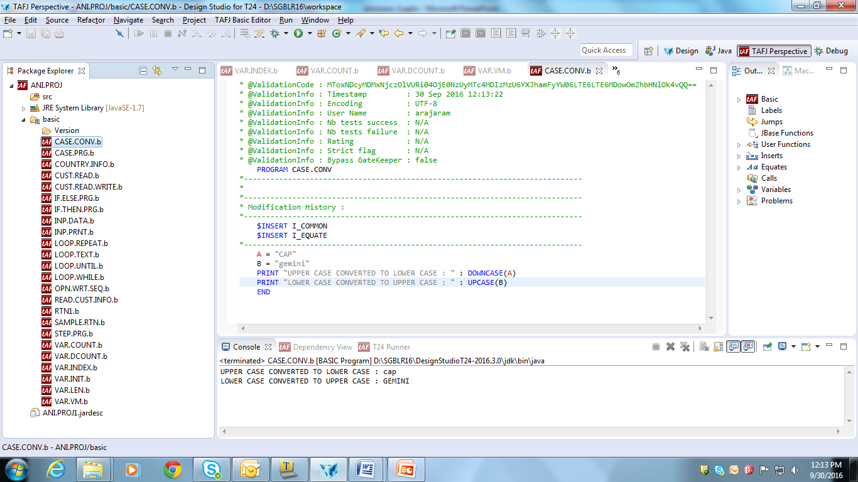
Solution
Write a program for case conversion, using UPCASE and DOWNCASE functions as shown

Slide 34
CHANGE
Changes occurrences of a character to another character in a record/string
Syntax:
CHANGE(e,d,c)
Where c & d – characters
e – string/record
Changes occurrences of d to c in e

Slide 35
Example
Write a routine to change the occurrence of e to i in the string “admenestrateon”

Slide 36
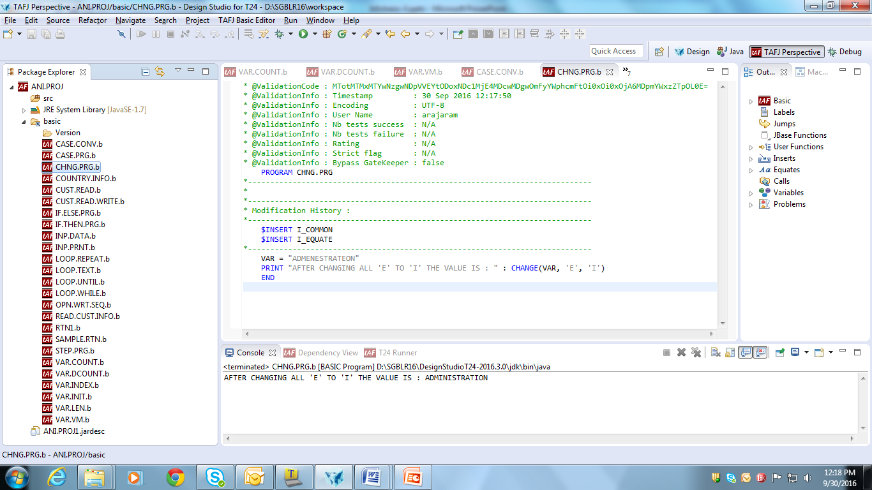
Solution
The occurrence of one character to another character is changed as shown

Slide 37
ICONV
Converts a given string into internal format onto the disk
SYNTAX:
ICONV(string,conversion code)
Various Conversion codes
D – Internal & External Dates
MD2 – Mask Decimal
DE – Decimal

Slide 38
Example
String - ICONV | Conversion Code | Result
15.00 | ‘MD2’ | 1500
12 MARCH 95 | ‘D’ | 9933
12.3.95 | ‘DI’ | 9933

Slide 39
OCONV
Converts internal format data into format specified
SYNTAX:
ICONV(string,conversion code)

Slide 40
Example
String - OCONV | Conversion Code | Result
1500 | ‘MD2’ | 15.00
9933 | ‘D’ | 12 MARCH 95
9933 | ‘DI’ | 12.3.95

Slide 41
Example
Write a program
To convert date ’12 MAR 95’ into internal date format ‘D’
To convert internal format code ‘9933’ into date format ‘D’

Slide 42
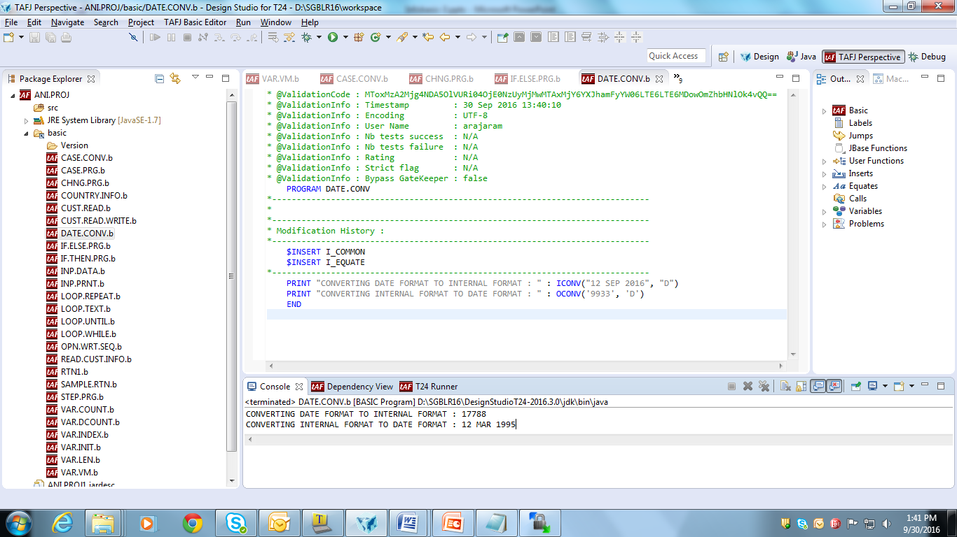
Solution
Write a program for format conversion using ICONV and OCONV as shown

Slide 43
PROMPT
Changes the prompt character displayed at the use of INPUT statement
Syntax:
PROMPT expr
Where,
expr can evaluate to any printable string
Enables easy identification of user-defined prompt

Slide 44
PROMPT
Example:
Input
PROMPT "Next answer : “
INPUT Answer
Output:
Next answer :
Notes:
Next answer appears as prompt & waits for input from user (due to “INPUT answer” in code)

Slide 45
Example
Write a program to change the prompt after receiving an input

Slide 46
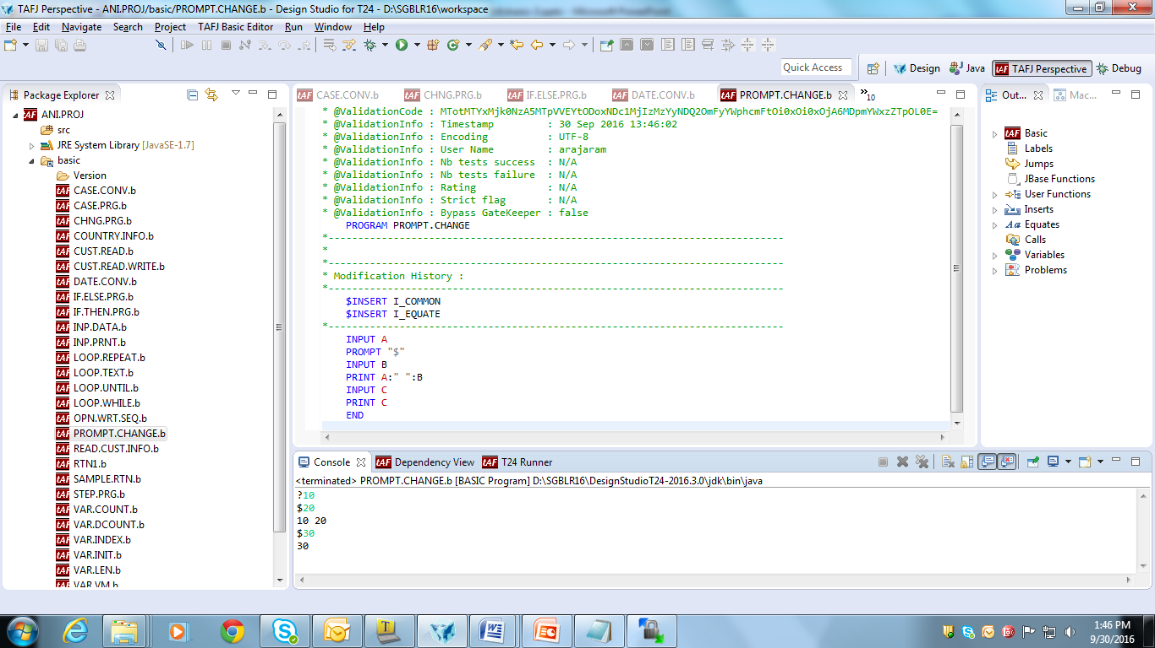
Solution

Slide 47
STRING MANIPULATION
Removes leading and trailing spaces available in a string
Used when storing data in database
During Enquiry selection, avoids cancellation of record from list

Slide 48
STRING MANIPULATION COMMANDS
TRIMF
Removes leading spaces from a string
Syntax: TRIMF(string)
TRIMB
Removes trailing spaces from a string
Syntax: TRIMB(string)
TRIM
Removes both leading &trailing spaces
Syntax: TRIM(string)

Slide 49
Example
Write a program to remove extra space from string ‘ CAP GEMINI ’, using TRIMF, TRIMB & TRIM

Slide 50
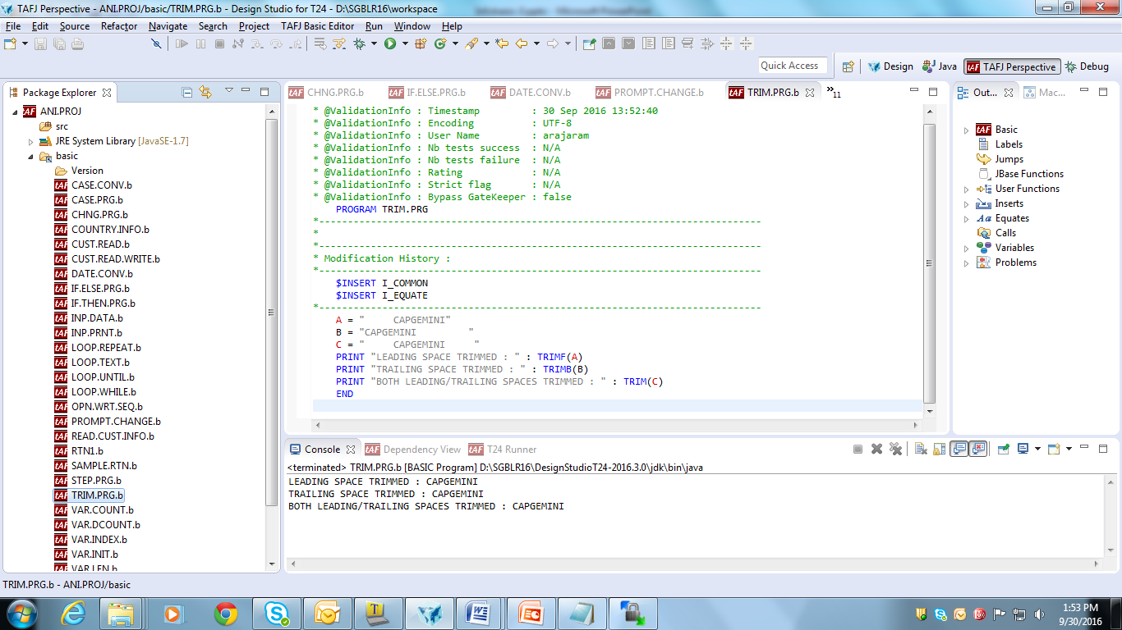
Solution

Slide 51
FIELD
Extracts sub-string from a Character string using delimiters
Syntax
FIELD(string,delimiter,occurrence,fields )
Example: FIELD command can be used in scenarios, when value of Nationality & Residence has to be picked from Customer records

Slide 52
Example
Write a program to extract character and number from a string using delimiters

Slide 53
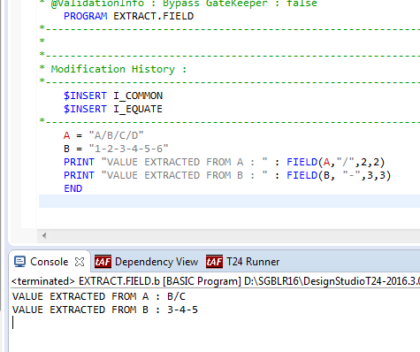
Solution

Slide 54
LOCATE
Search a string in a dynamic array and get its position
Returns the field Position only
Syntax:
LOCATE <string> IN <array> {<field pos,multivalue pos>} SETTING <var> THEN/ELSE <statements>
Used during extraction of string from a large array
E.g. On a condition when Nationality and Residence of Customer is US, so as to do some action

Slide 55
Example
Write a program to locate available and unavailable string in a given array

Slide 56
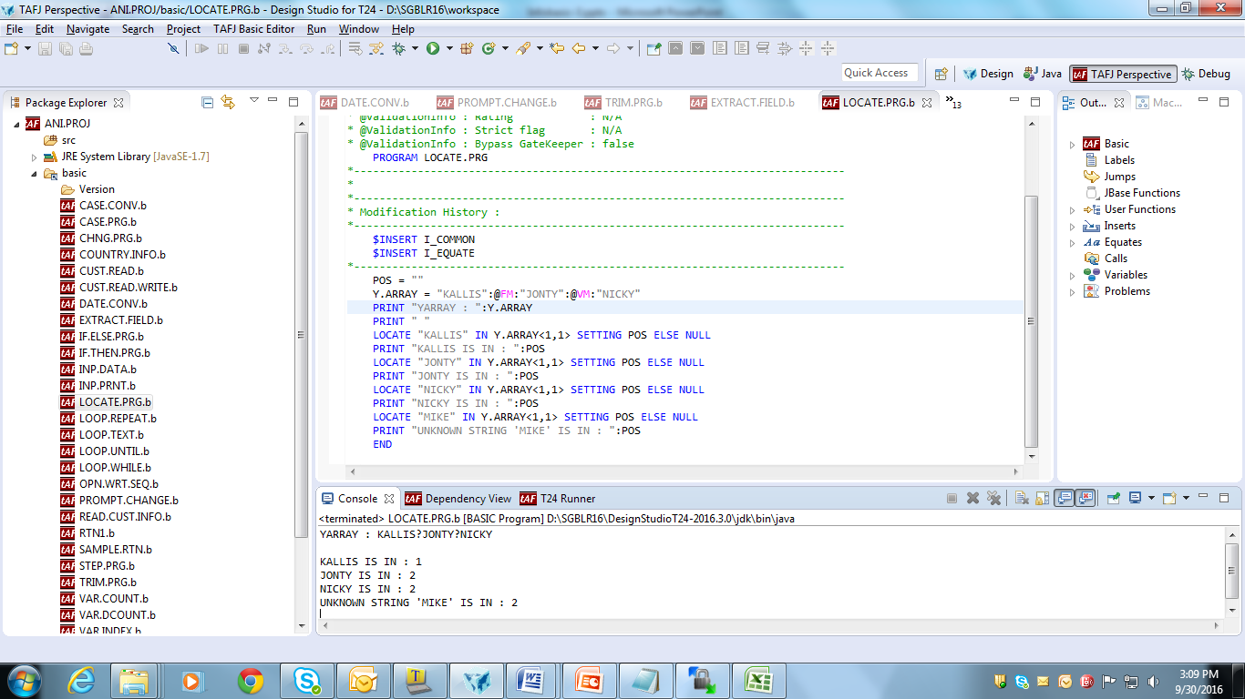
Solution

Slide 57
Array position
ARRAY(X,Y,Z)
Field Marker
Value Marker
Sub-Value Marker

Slide 58
Example
Write a program to locate the position of JONTY at (2,1,1), and NEHA at (2,2,2) and (2,3,2) in the following array 'KALLIS':@FM:'JONTY':@VM:'NICKY':@SM:'ROHAN':@SM:'NEHA':@FM:'VENSRI':@VM:'NONI':@FM:'NITIN':@VM:'PRINCY':@SM:'VENKI'
Solution:
When locating JONTY at array position (2,1,1), it is found directly at position 1
When locating NEHA at array position (2,2,2), it is found in position 3
When locating NEHA at array position (2,3,2), it is not found

Slide 59
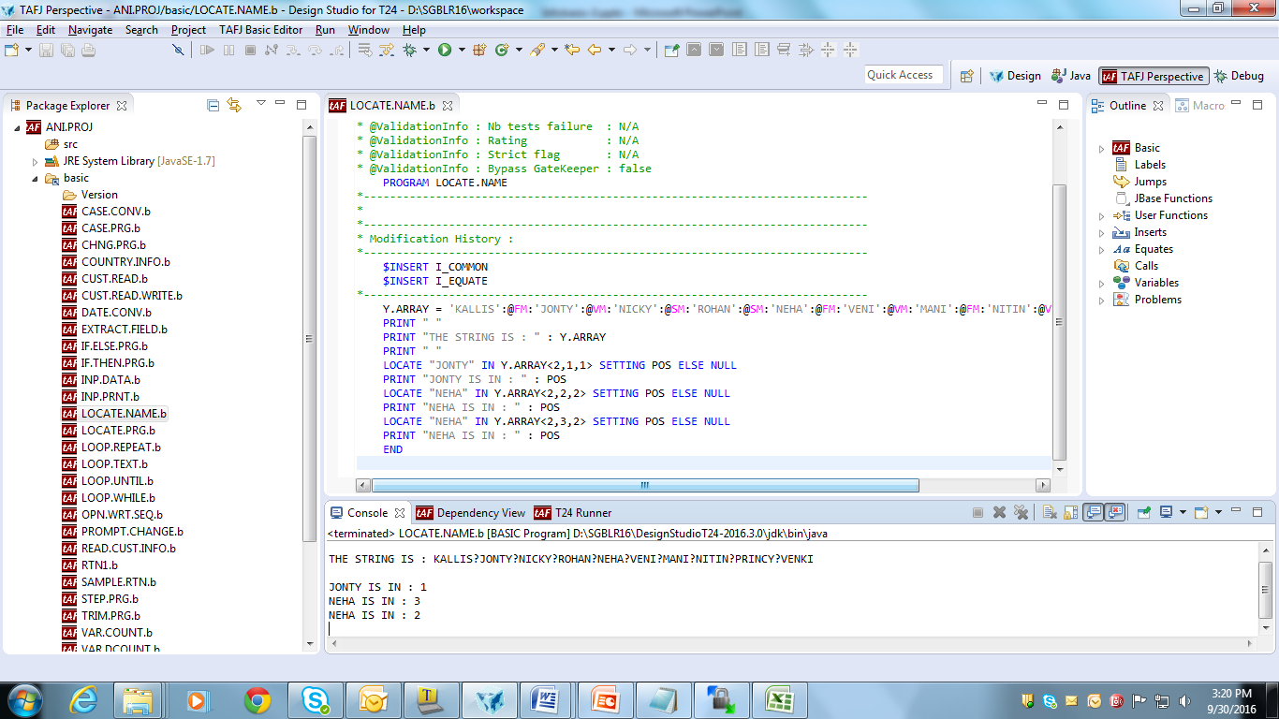
Solution

Slide 60
FIND
Searches the position of entire string in a dynamic array
Finds the location of a specified string within a Dynamic array
Syntax:
FIND <string> IN <array> SETTING var1,var2,var3 THEN/ELSE <statements>
Example:
On condition, when accounts whose Account Officer corresponds to specific value has to be found

Slide 61
Example
Write a program to find the array position of string ‘2000’ in a given array ‘ABCD’:@FM:’1000’:@VM:’2000’

Slide 62
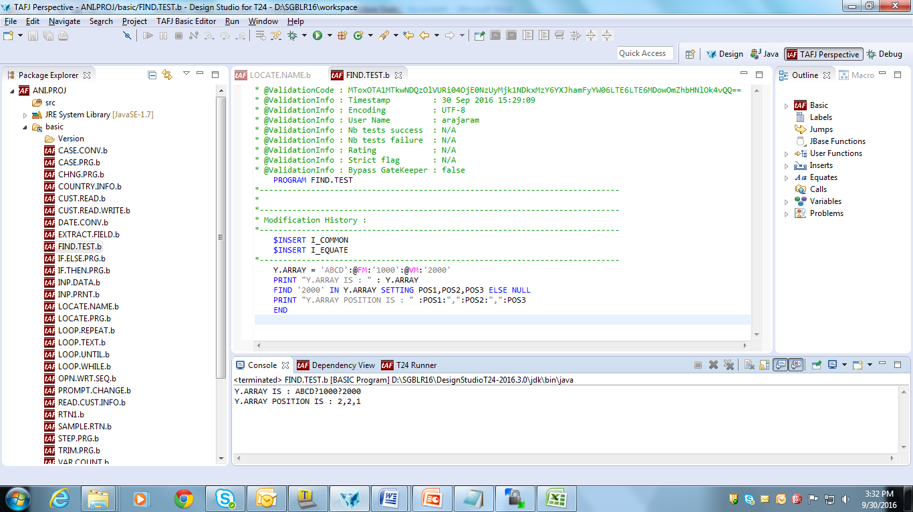
Solution

Slide 63
FINDSTR
Searches a string as a substring in dynamic array
Syntax:
FINDSTR <string> IN <array> SETTING var1,var2,var3 THEN/ELSE <statements>
Example:
On condition, when Accounts whose Account.Title containing specified string has to be found

Slide 64
Example
Write a program to display the array position of a sub-string ‘ONT’ of a string ‘JONTY’ in a given array ‘KALLIS’:@FM:’JONTY’:@VM:’NICKY’

Slide 65
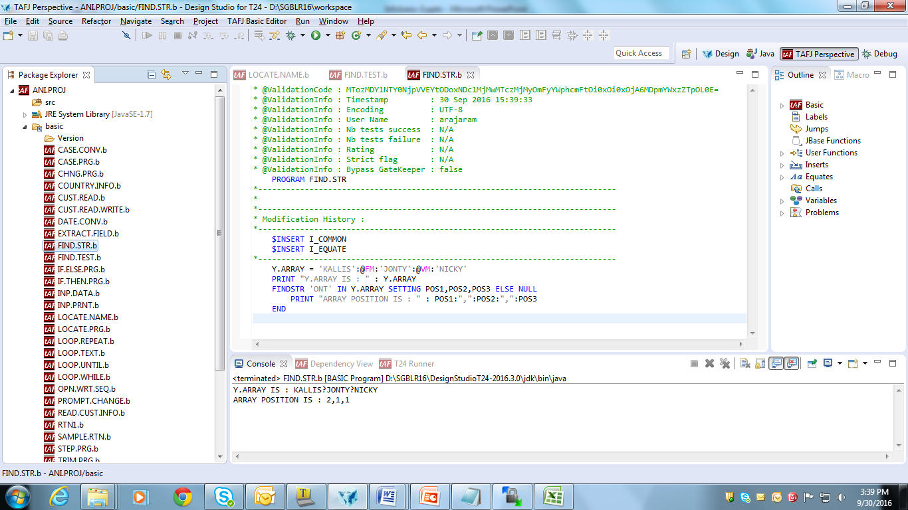
Solution

Slide 66
Summary
To summarize the commands that we have learnt so far,
LEN(e) -> Length of the text in expression
INDEX(a,e,d) -> Position of specific occurrence of e
COUNT(e,d) -> Number of occurrences of d in e
DCOUNT(e,d) -> Number of occurrences of d in e, +1

Slide 67
Summary
UPCASE(e) -> Converts e to uppercase
DOWNCASE(e) -> Converts e to lowercase
CHANGE(e,d,c) -> Change occurrences of d to c in e
ICONV(e,d) -> Convert e into format specified in d
OCONV(e,d) -> Convert e into format specified in d

Slide 68
Summary
PROMPT -> Changes prompt character during input
STRING MANIPULATION
TRIMF –> Removes leading space
TRIMB –> Removes trailing space
TRIM –> Removes both leading & trailing space
FIELD –> Extracts sub-string from a string using delimiters

Slide 69
Summary
LOCATE –> Finds position of string in dynamic array
FIND –> Searches the entire string in a dynamic array
FINDSTR –> Searches a string as substring in dynamic array

Slide 70


www.capgemini.com/financialservices

